Slide 1




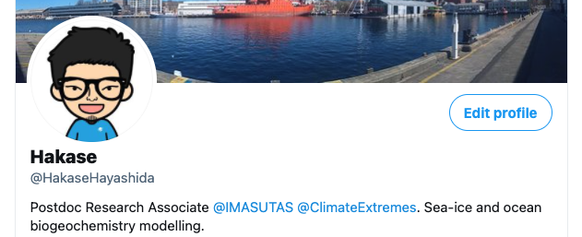
Ocean and sea-ice biogeochemistry (BGC) of ACCESS-OM2

Slide 2
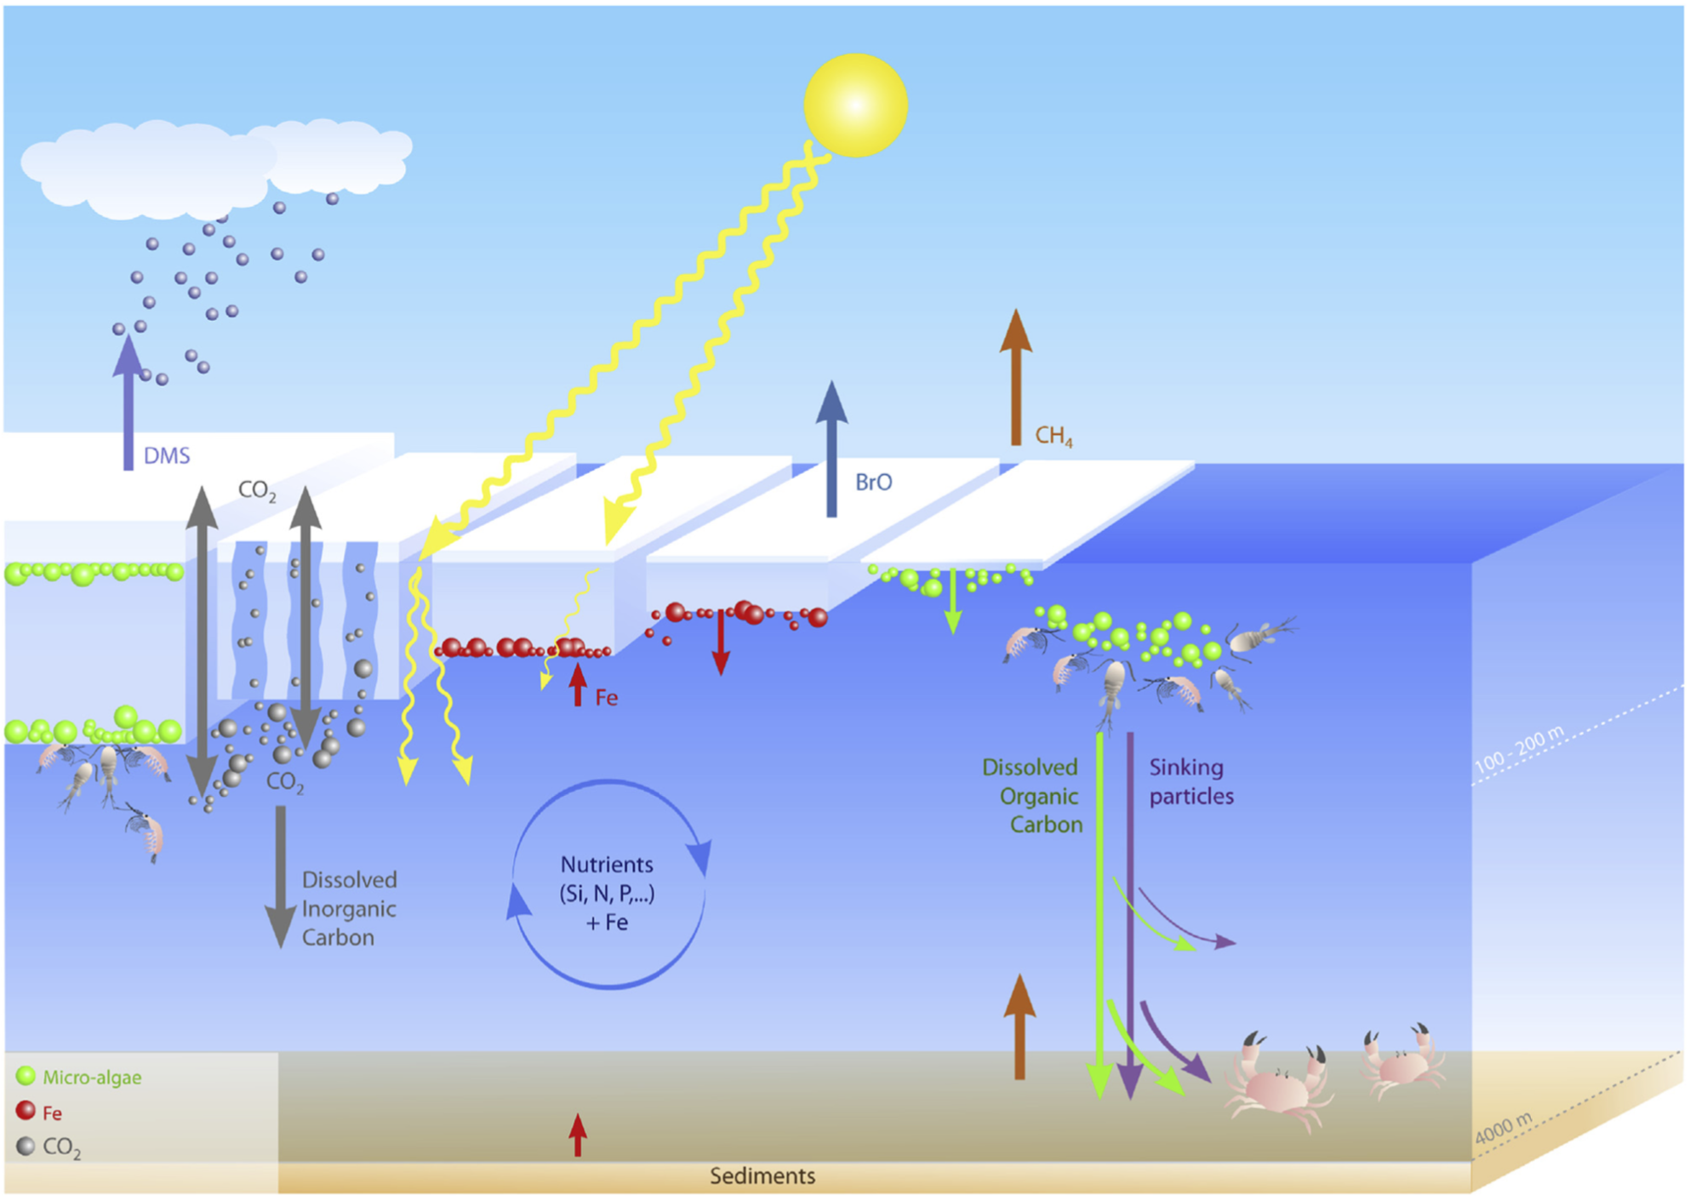
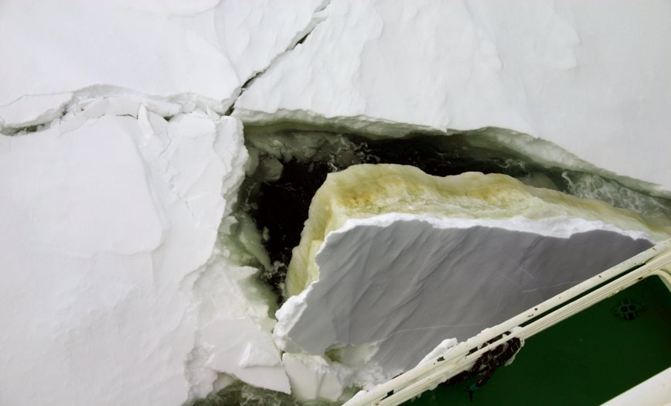
Photo credit: Delphine Lannuzel
No CMIP6 ESMs incorporate sea-ice BGC component!
Vancoppenolle et al. (2013)

Slide 3
BGC implementation into ACCESS-OM2
ACCESS-OM2
CICE 5.1.2
Nitrate
Ice algae
Fe, O2, DIC, TA, CaCO3, ADIC
MOM 5.1
Nitrate
Phytoplankton
Detritus
Zooplankton

Slide 4
Ice algae
Phytoplankton
Relative contribution of ice algae to the total annual net primary production
Ice algae dominating
Annual net primary production (g C m⁻² yr⁻¹) averaged over 1958-2018
Phytoplankton dominating

Slide 5

Conclusions
Incorporation of sea-ice BGC is a novel aspect of ACCESS-OM2, which extends our research capability to ice-covered ecosystems.
ACCESS-OM2-BGC contributions to MIPs:
CMIP6-OMIP (Ocean MIP; two realizations about to be submitted)
IAMIP2 (Ice Algae MIP; Hayashida et al., in review, GMDD)
Next steps:
Official release of ACCESS-OM2-BGC on github
Higher-resolution (0.25º and 0.1º) BGC simulations

